Slide 1
MTA Project
Jack Casalino, Jack Schlendorf, Annie Cheng

Slide 2
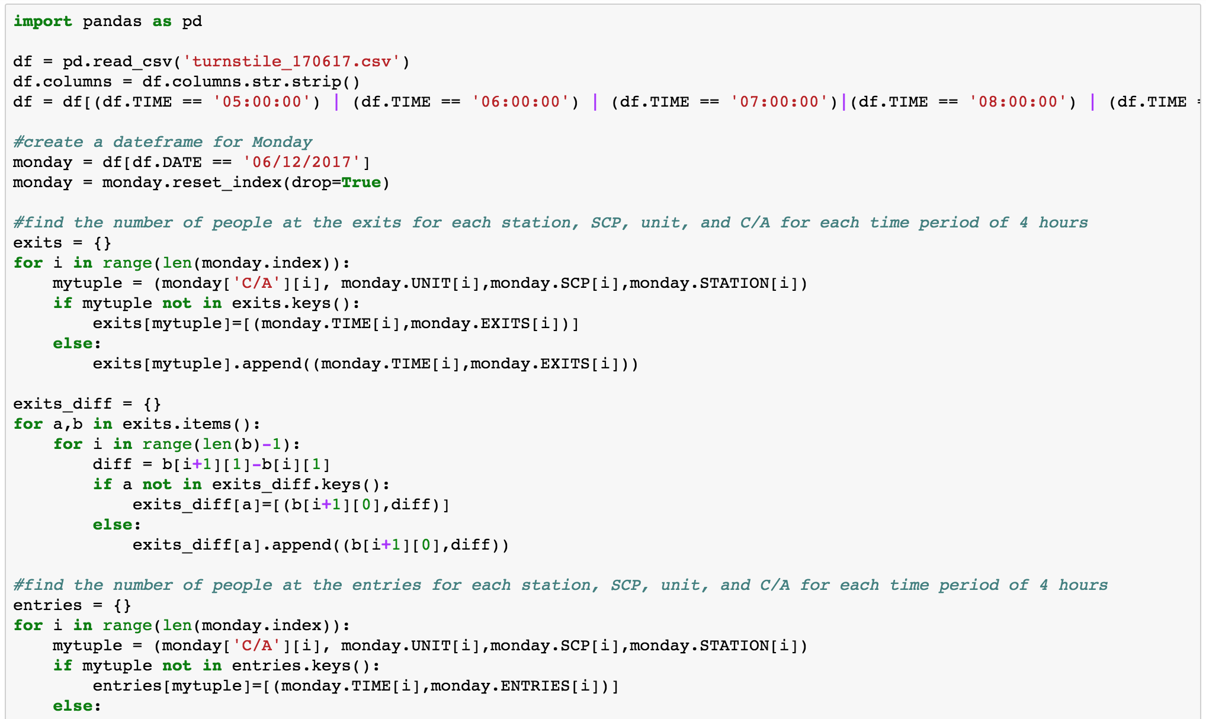
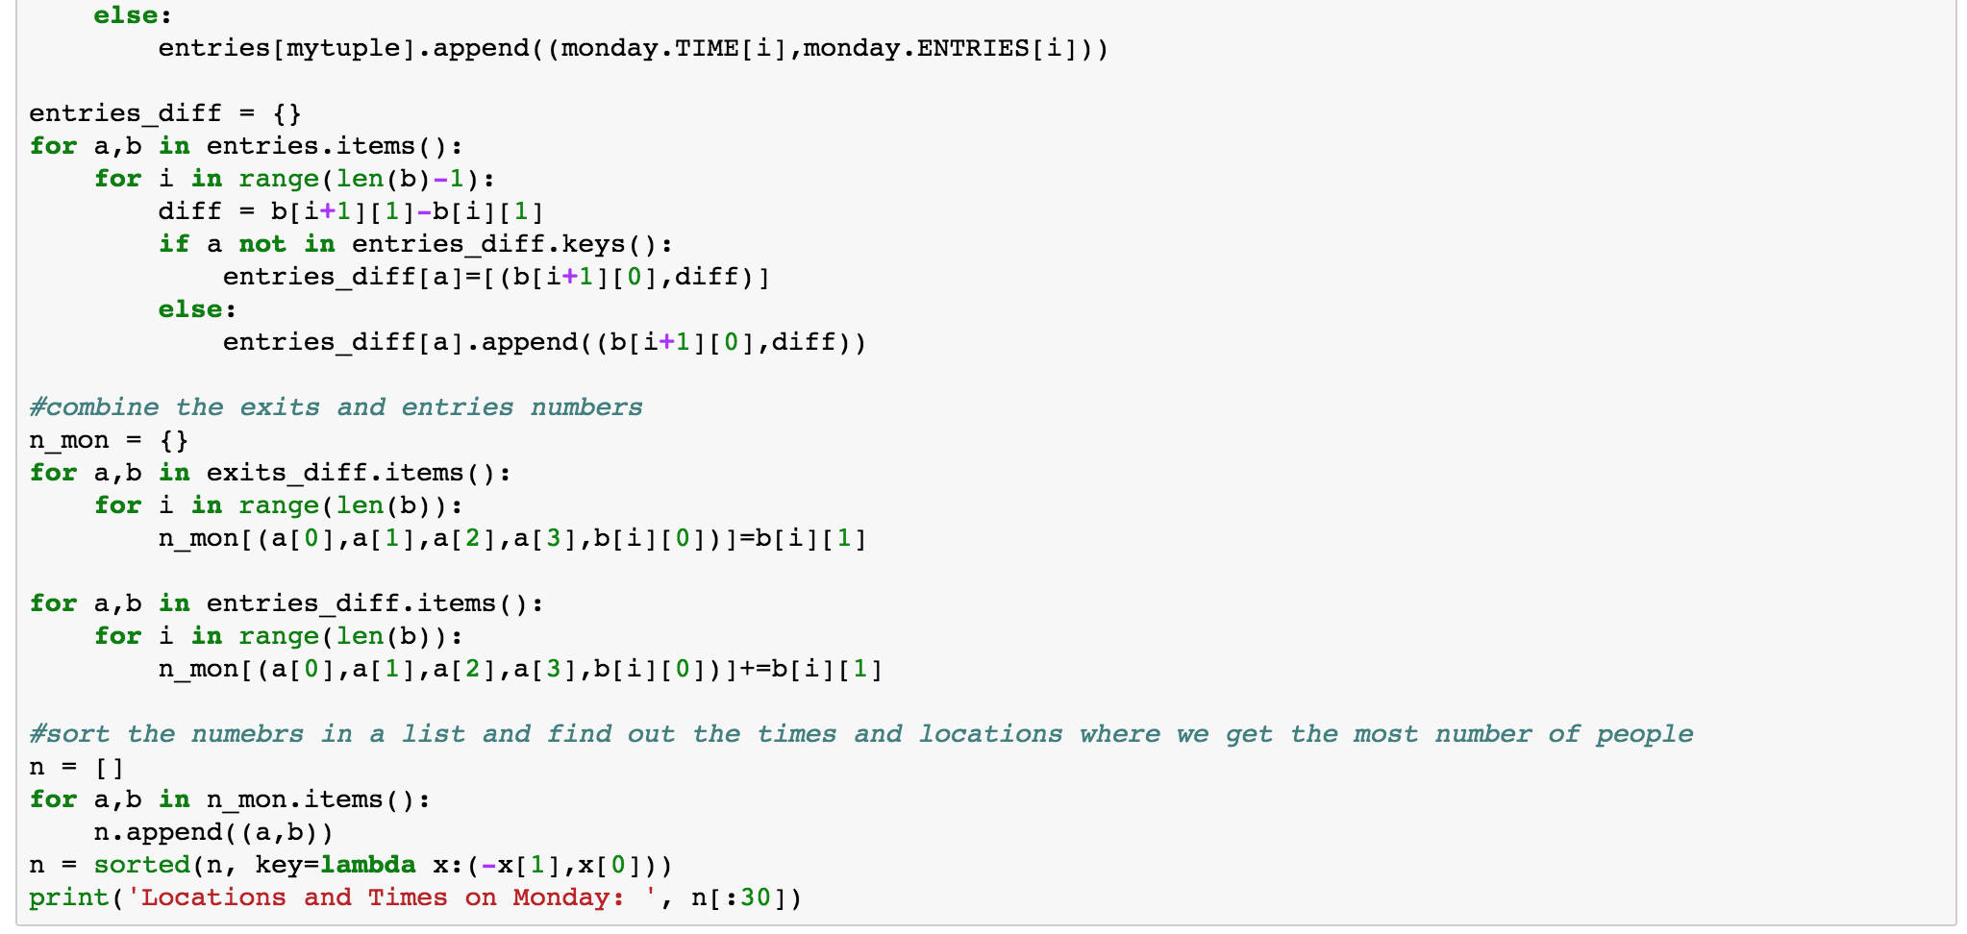
Codes for finding the stops
Dataframe for that specific day (Monday/Saturday/Sunday)
# of people at the exits for each station every 4 hrs
The same thing for the entries
Combine the exits and entries numbers
Sort the numbers in a list and find out the times and locations where we get the most number of people

Slide 3
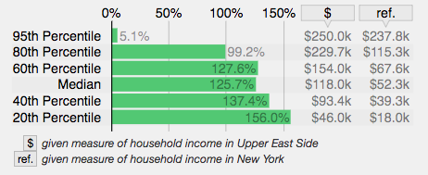
Our Strategy: Optimizing Donations + People
This graph shows how much wealthier Upper East Siders in each percentile are than their NY counterparts.
Notes:
For example, the median resident of the Upper East Side makes 118k versus the 52k of the median New York City resident––that’s an extra 125%. The graphic shows how much more each percentile of Upper East Siders makes than their city-average counterpart. There are several neighborhoods that make more money, but they all have much lower populations and much smaller subway stops.

Slide 4
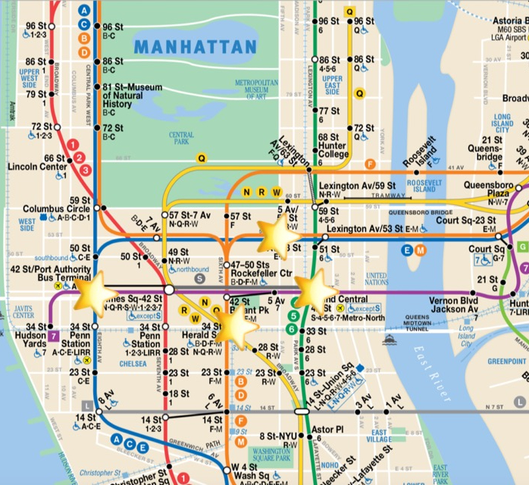
Subway Traffic on Weekdays (Manhattan):
Fewer, but higher density stops
Almost all dense traffic stops are in Midtown

Slide 5
Weekday Volunteer Schedule:
42 ST-PORT AUTH - 4-8PM x 2 volunteers
GRD CNTRL-42 ST - 8-12AM x 2 volunteers
GRD CNTRL-42 ST - 4-8PM x 2 volunteers
5 AVE - 12-4pm x 2 volunteer
34 ST-HERALD SQ - 4-8PM x 2 volunteer

Slide 6
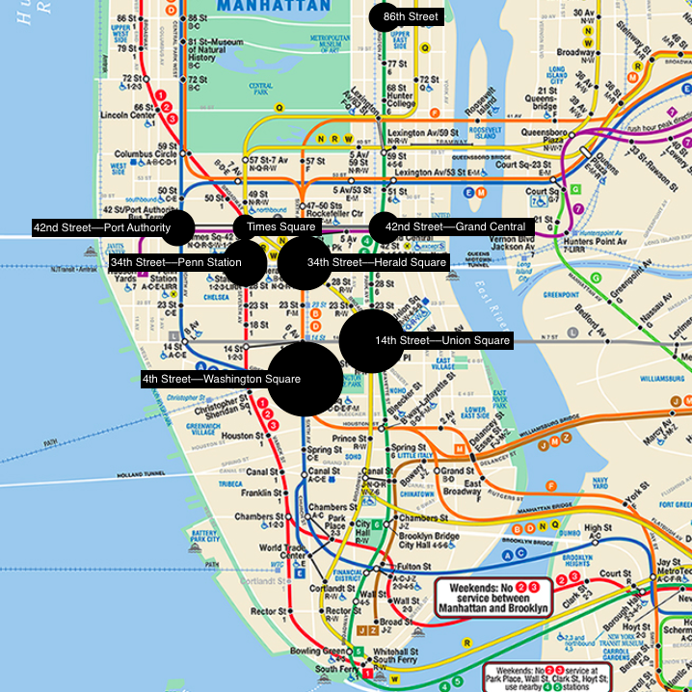
Subway Traffic on Sunday
All stops with >1100 exits, focused on Manhattan
Notes:
This map shows all subway stops with one or more high-traffic turnstiles, sized based on foot traffic.

Slide 7
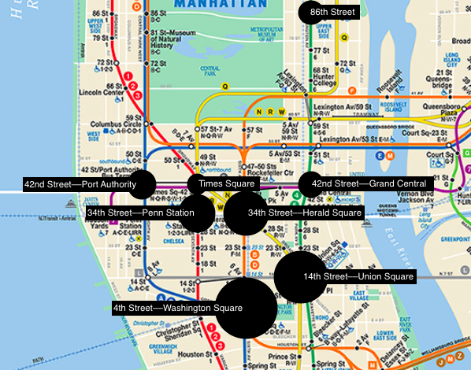
Subway Traffic on Sunday
Zoomed in on high-traffic area
Notes:
Here’s the the busiest part of the subway on Sundays, midtown Manhattan.

Slide 8
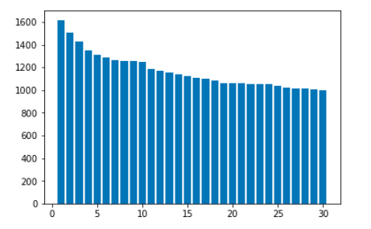
Turnstile Rank vs. Passenger Volume
Color coded by turnstile, scaled by volume
Notes:
Here’s another way of visualizing this data, with each color representing a station and each bar representing a specific turnstile. The X axis is turnstile rank, the Y axis is the foot traffic for that turnstile.

Slide 9
Subway Traffic on Sunday
Upper Manhattan, with high income area in blue

Slide 10
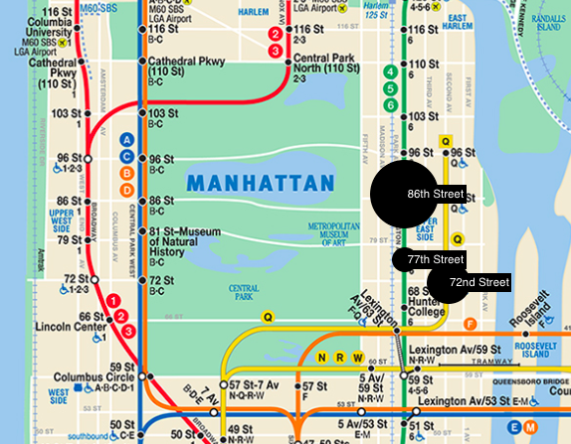
Subway Traffic on Sunday (zoomed in on Upper Manhattan)
Notes:
These three stations account for most of the traffic on the Upper East Side. The median user of these three stations makes more than twice the salary of the typical New Yorker at any of the other stations. Additionally, the foot traffic in the 86th street subway station is in the 98th percentile of the 472 NY subway stations, and 72nd street station foot traffic is in the 94th percentile.

Slide 11
1 Volunteer
2 Volunteers
3 Volunteers
W 4 ST-WASH SQ
14 ST-UNION SQ
GRD CNTRL
77th ST
34 ST-HRLD SQ
34 ST-PENN STA
42 ST-PORT AUTH
86 ST
72nd ST
4 pm
5 pm
6 pm
7 pm
8 pm
9 pm
10pm

Slide 12
Sunday Volunteer Schedule
West 4th St., Washington Square, 5-7 pm (3), 9-11 pm (2)
14th St., Union Square, 5-7 pm (2)
34th St., Herald Square 4-6 pm (2)
34th St., Penn Station, 8-10 pm, 4-6 pm (2)
42nd St., Port Authority, 8-10 pm (2)

Slide 13
Sunday Volunteer Schedule, continued
Grand Central, 42nd St., 5-7 pm (1)
86th St., 4-6 pm (3)
77th St., 5-7 pm (1)
72nd St., 4-6 pm (2)

Slide 14
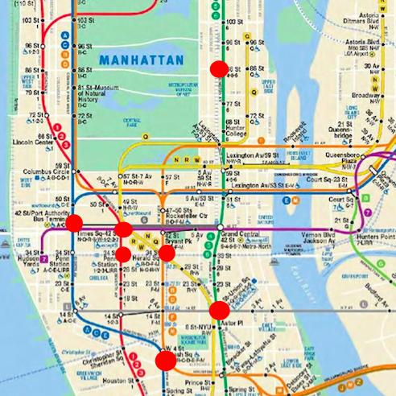
Subway Traffic on Saturday (Manhattan):
Fewer, but higher density stops
Midtown, Upper East Side, Brooklyn focused

Slide 15
Saturday Volunteer Schedule:
Bedford Ave - 6-8PM x 3 volunteers
W 4 ST-Wash Sq - 5- 7PM x 2 volunteers
14 St-Union Sq - 6-8PM x 2 volunteers
34th Street - Herald Sq -4 -6PM x 2 volunteers

Slide 16
Saturday Volunteer Schedule cont.
York St - 2-6PM x 2 volunteers
72nd St - 5-7PM x 3 volunteers
86th St - 4-6PM x 2 volunteers
77th St - 4-6PM x 2 volunteers

Slide 17
Citations
Subway traffic data from the Metropolitan Transit Authority Website, http://web.mta.info/maps/submap.html
Income data from the Statistical Atlas, https://statisticalatlas.com/neighborhood/New-York/New-York/Upper-East-Side/Household-Income

